Slide 1
9/4/2024
General Uncertainty Principle
Wavefunctions
Constraints on wavefunctions
Penetration into barriers
Quantization
Exponential solutions to the Schrodinger Equation
Free Particle, as a superposition of two or many states
Penetration, into a barrier with infinite width and finite height
Tunneling, through a barrier with finite width and finite height
Particle in a box
Harmonic Oscillator
This lecture is designed to help you achieve the following learning objectives
Use the general uncertainty principle to evaluate limits on the simultaneous specification of a pair of quantities
Explain quantum tunneling
Obtain and interpret solutions of the Schrodinger equation for tractable systems including the particle in a box, harmonic oscillator, rigid rotor, and hydrogen atom

Slide 2
General Uncertainty Principle
Remember that if $[\overset{̂}{A},\overset{̂}{B}]=0$, the two operators commute
According to the uncertainty principle,
If two operators commute, then their corresponding observables can be simultaneously specified.
If two operators do not commute, then their corresponding observables cannot be simultaneously specified. They are complementary observables.
This is counterintuitive
Heisenberg uncertainty principle: $ΔxΔp_{x}≥\frac{1}{2}ℏ$
General uncertainty principle: $ΔAΔB≥\frac{1}{2}\left|⟨[\overset{̂}{A},\overset{̂}{B}]⟩\right|$, where $ΔA={\left\{⟨A^{2}⟩-{⟨A⟩}^{2}\right\}}^{\frac{1}{2}}$

Slide 3
Properties of Wavefunctions
Remember from the postulates,
1. The state of a system is fully described by a function $Ψ(r_{1},r_{2},...,t)$, known as the wavefunction
4. The probability that a particle will be found in the volume element $dτ$ at the point $r$ is proportional to $|Ψ(r)|^{2}dτ$.
5. Satisfies the Schrodinger equation, $iℏ\frac{∂Ψ}{∂t}=\overset{̂}{H}Ψ$. If the potential energy is time-independent, then $\overset{̂}{H}Ψ=EΨ$. (In 1D, $\overset{̂}{H}Ψ=-\frac{ℏ}{2m}\frac{∂^{2}Ψ}{∂x^{2}}+V(x)Ψ$.)

Slide 4
Constraints
Because $|Ψ|^{2}$ is a probability density that satisfies the Schrodinger equation, $Ψ$,
Cannot be infinite over a finite region
Must be single-valued
Have a second derivative, as the Schrodinger equation includes a second derivative. This implies that the function is continuous and has a continuous first derivative, except in ill-behaved regions of the potential.

Slide 5
“Curvature” of wavefunctions
Rearranging the 1D time-independent Schrodinger equation gives, $\frac{d^{2}Ψ}{dx^{2}}=\frac{2m}{ℏ^{2}}(V-E)Ψ$, showing that “curvature” depends on the difference between the potential and total energy.
In a classical system, what happens when all of the energy is converted into potential energy?
In a quantum system, there is some probability of penetration into the classically forbidden region.
Energy, E
Potential
Energy, V
Position, x
Wavefunction, $Ψ$

Slide 6
Boundaries and Quantization
$$\frac{d^{2}Ψ}{dx^{2}}=\frac{2m}{ℏ^{2}}(V-E)Ψ$$
As $x→∞$, the wavefunction must approach zero. For $Ψ(x)=y$,
If curvature too small, wavefunction goes to $∞$
If curvature too large, wavefunction goes to $-∞$
Thus only certain energies are allowable
If a system is confined to a finite region of space, the energy is quantized
If there is a single boundary, then energy is not quantized
Energy, E
Potential
Energy, V
Position, x
Wavefunction, $Ψ$

Slide 7
$$\frac{d^{2}Ψ}{dx^{2}}=\frac{2m}{ℏ^{2}}(V-E)Ψ$$
Another way to look at it:
if we force the wavefunction of a bound system to not blow up, it will only be continuous for certain energies
https://dkirkby.github.io/quantum-demo/media/stepBound.gif

Slide 8
Exponential Solutions
For a 1D system with constant V, the time-independent Schrodinger equation is $-\frac{ℏ^{2}}{2m}\frac{d^{2}Ψ}{dx^{2}}+VΨ=EΨ$. When V = 0, the system is known as a free particle.
The general solution is $Ψ=Ae^{ikx}+Be^{-ikx}$, with $k={\left(\frac{2m(E-V)}{ℏ^{2}}\right)}^{1/2}$
As Euler’s formula is $e^{ix}=cos(x)+isin(x)$, another way to write the general solution is, $Ψ=Ccos(kx)+Dsin(kx)$.
Is there quantization? In other words, is E restricted to specific values?
No

Slide 9
Self-test of Postulate 3
Remember from postulate 3 that for an eigenfunction expansion $Ψ=\underset{m}{∑}c_{m}Ψ_{m}$, the probability of measuring a particular eigenvalue $ω_{n}$ is proportional to $|c_{m}|^{2}$.
Given that $Ψ=Ae^{ikx}+Be^{-ikx}$, $k={\left(\frac{2mE}{ℏ^{2}}\right)}^{1/2}$, and $\overset{̂}{p}=\frac{ℏ}{i}\frac{d}{dx}$, what values of the linear momentum may be observed? What are their probabilities?
$p=ℏk$ with probability $|A|^{2}$ and $p=-ℏk$ with probability $|B|^{2}$

Slide 10
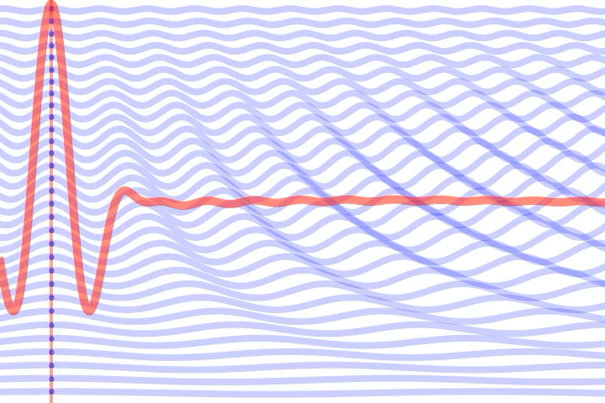
Wave Packet
If the wavefunction has the form $Ψ=Ae^{ikx}+Be^{-ikx}$, then there are
two possible momenta
one possible energy
How well defined is the position?
It is a free particle
A wave packet is a superposition of $Ψ=Ae^{ikx}+Be^{-ikx}$ with different k. The energy is less well defined, but position is better defined.
https://dkirkby.github.io/quantum-demo/

Slide 11

Barrier with finite height & infinite width
$$V(x)=\{\begin{matrix}0 & \text{if}x<0 \\ V & \text{if}x≥0\end{matrix}$$
Same general solution, different coefficients in different regions
$$∞→$$
0

Slide 12
Quantum Penetration
Zone I (x < 0, V(x) = 0)
$Ψ=Ae^{ikx}+Be^{-ikx}$, $k={\left(\frac{2mE}{ℏ^{2}}\right)}^{1/2}$
Zone II (x > 0, V(x) = V):
$Ψ=A^{′}e^{ik^{′}x}+B^{′}e^{-ik^{′}x}$, $k^{′}={\left[\frac{2m(E-V)}{ℏ^{2}}\right]}^{1/2}$, where k’ is imaginary. This is nonzero, showing penetration
$Ψ=A^{′}e^{-κ^{′}x}+B^{′}e^{κ^{′}x}$, $k={\left[\frac{2m(V-E)}{ℏ^{2}}\right]}^{1/2}$, where $k^{′}=iκ^{′}$. Thus, B’ must be zero. The wave function decays exponentially into the barrier.
How does the extent of penetration depend on particle mass and energy?
$$∞→$$
0

Slide 13
Barrier with finite height & finite width
$$V(x)=\{\begin{matrix}0 & \text{if}x<0 \\ V & \text{if}0≤x<w \\ 0 & \text{if}x≥w\end{matrix}$$
Same general solution, different coefficients in different regions
$$←w→$$
0

Slide 14
Quantum Tunneling
Zone I (x < 0, V(x) = 0)
$Ψ=Ae^{ikx}+Be^{-ikx}$, $k={\left(\frac{2mE}{ℏ^{2}}\right)}^{1/2}$
Zone II (0 < x < w, V(x) = V):
$Ψ=A^{′}e^{ik^{′}x}+B^{′}e^{-ik^{′}x}$, $k^{′}={\left[\frac{2m(E-V)}{ℏ^{2}}\right]}^{1/2}$
Zone III (x > w, V(x) = 0)
$$Ψ=A^{′′}e^{ikx}+B^{′′}e^{-ikx}$$
For E<V, solution for tunneling probability is,
$$T=\frac{1}{1+\frac{e^{κL}-e^{-κL}}{16(E/V)(1-E/V)}}$$
Based on continuity of function and slopes
$$←w→$$
0

Slide 15
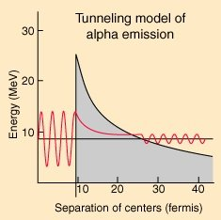
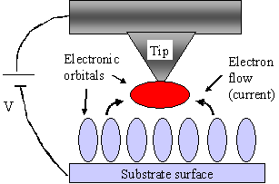
Quantum Tunneling Applications
https://minerva.union.edu/malekis/ESC24/KoskywebModules/cp_intr2.htm
Scanning Tunneling Microscopy
https://physicsopenlab.org/2017/05/30/tunnel-effect/
Explaining α decay

Slide 16
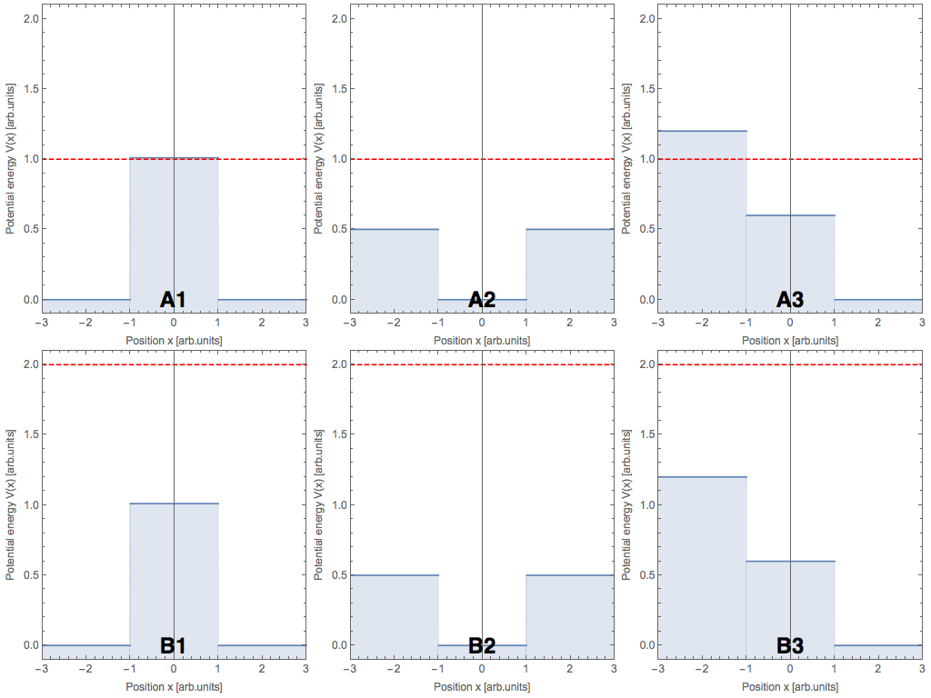
Potentials
Wavefunctions

Slide 17
Particle in a Box
$$V(x)=\{\begin{matrix}∞ & \text{if}x<0 \\ 0 & \text{if}0≤x<L \\ ∞ & \text{if}x≥L\end{matrix}$$
$$←$$
$$←$$
$$←∞$$
$$∞→$$
0
L

Slide 18
Solving the PIB
Inside the box, the general solution is $Ψ=Ccos(kx)+Dsin(kx)$, where $k={\left(\frac{2mE}{ℏ^{2}}\right)}^{1/2}$
Outside the box, $Ψ=0$
Because $Ψ(0)=0$ and $Ψ(L)=0$,$C=0$.
The solutions are $Ψ(x)=Dsin(kL)$, where $k=\frac{nπ}{L}$ to be zero at the boundaries
$$←$$
$$←$$
$$←∞$$
$$∞→$$
0
L

Slide 19
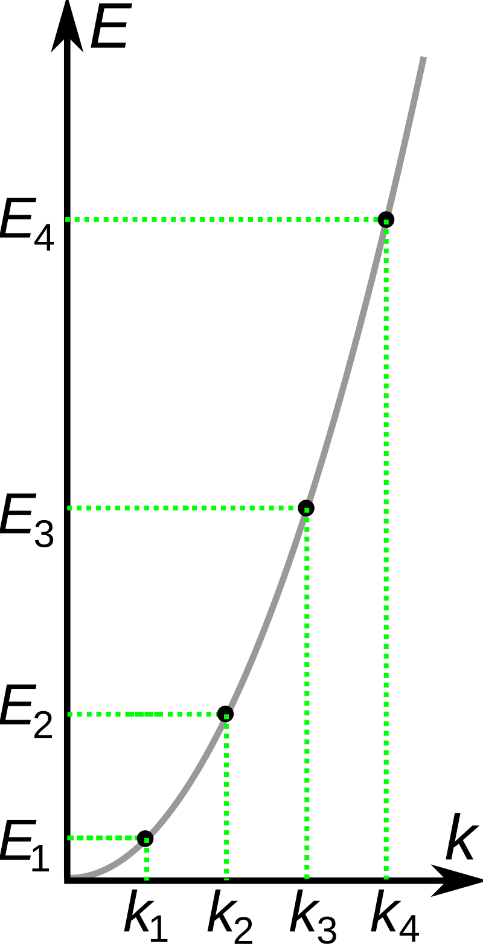
PIB energies
Setting two expressions for k equal, $\frac{\sqrt{2mE}}{ℏ}=\frac{nπ}{L}$
The allowable energies are $E=\frac{n^{2}π^{2}ℏ^{2}}{2mL^{2}}=\frac{n^{2}h^{2}}{8mL^{2}}$, for n = 1, 2, …
The PIB is a bound state with quantization
The lowest possible energy for a particle is NOT zero (even at 0 K). This means the particle always has some kinetic energy.
By Papa November - Own work, CC BY-SA 3.0, https://commons.wikimedia.org/w/index.php?curid=8652690

Slide 20
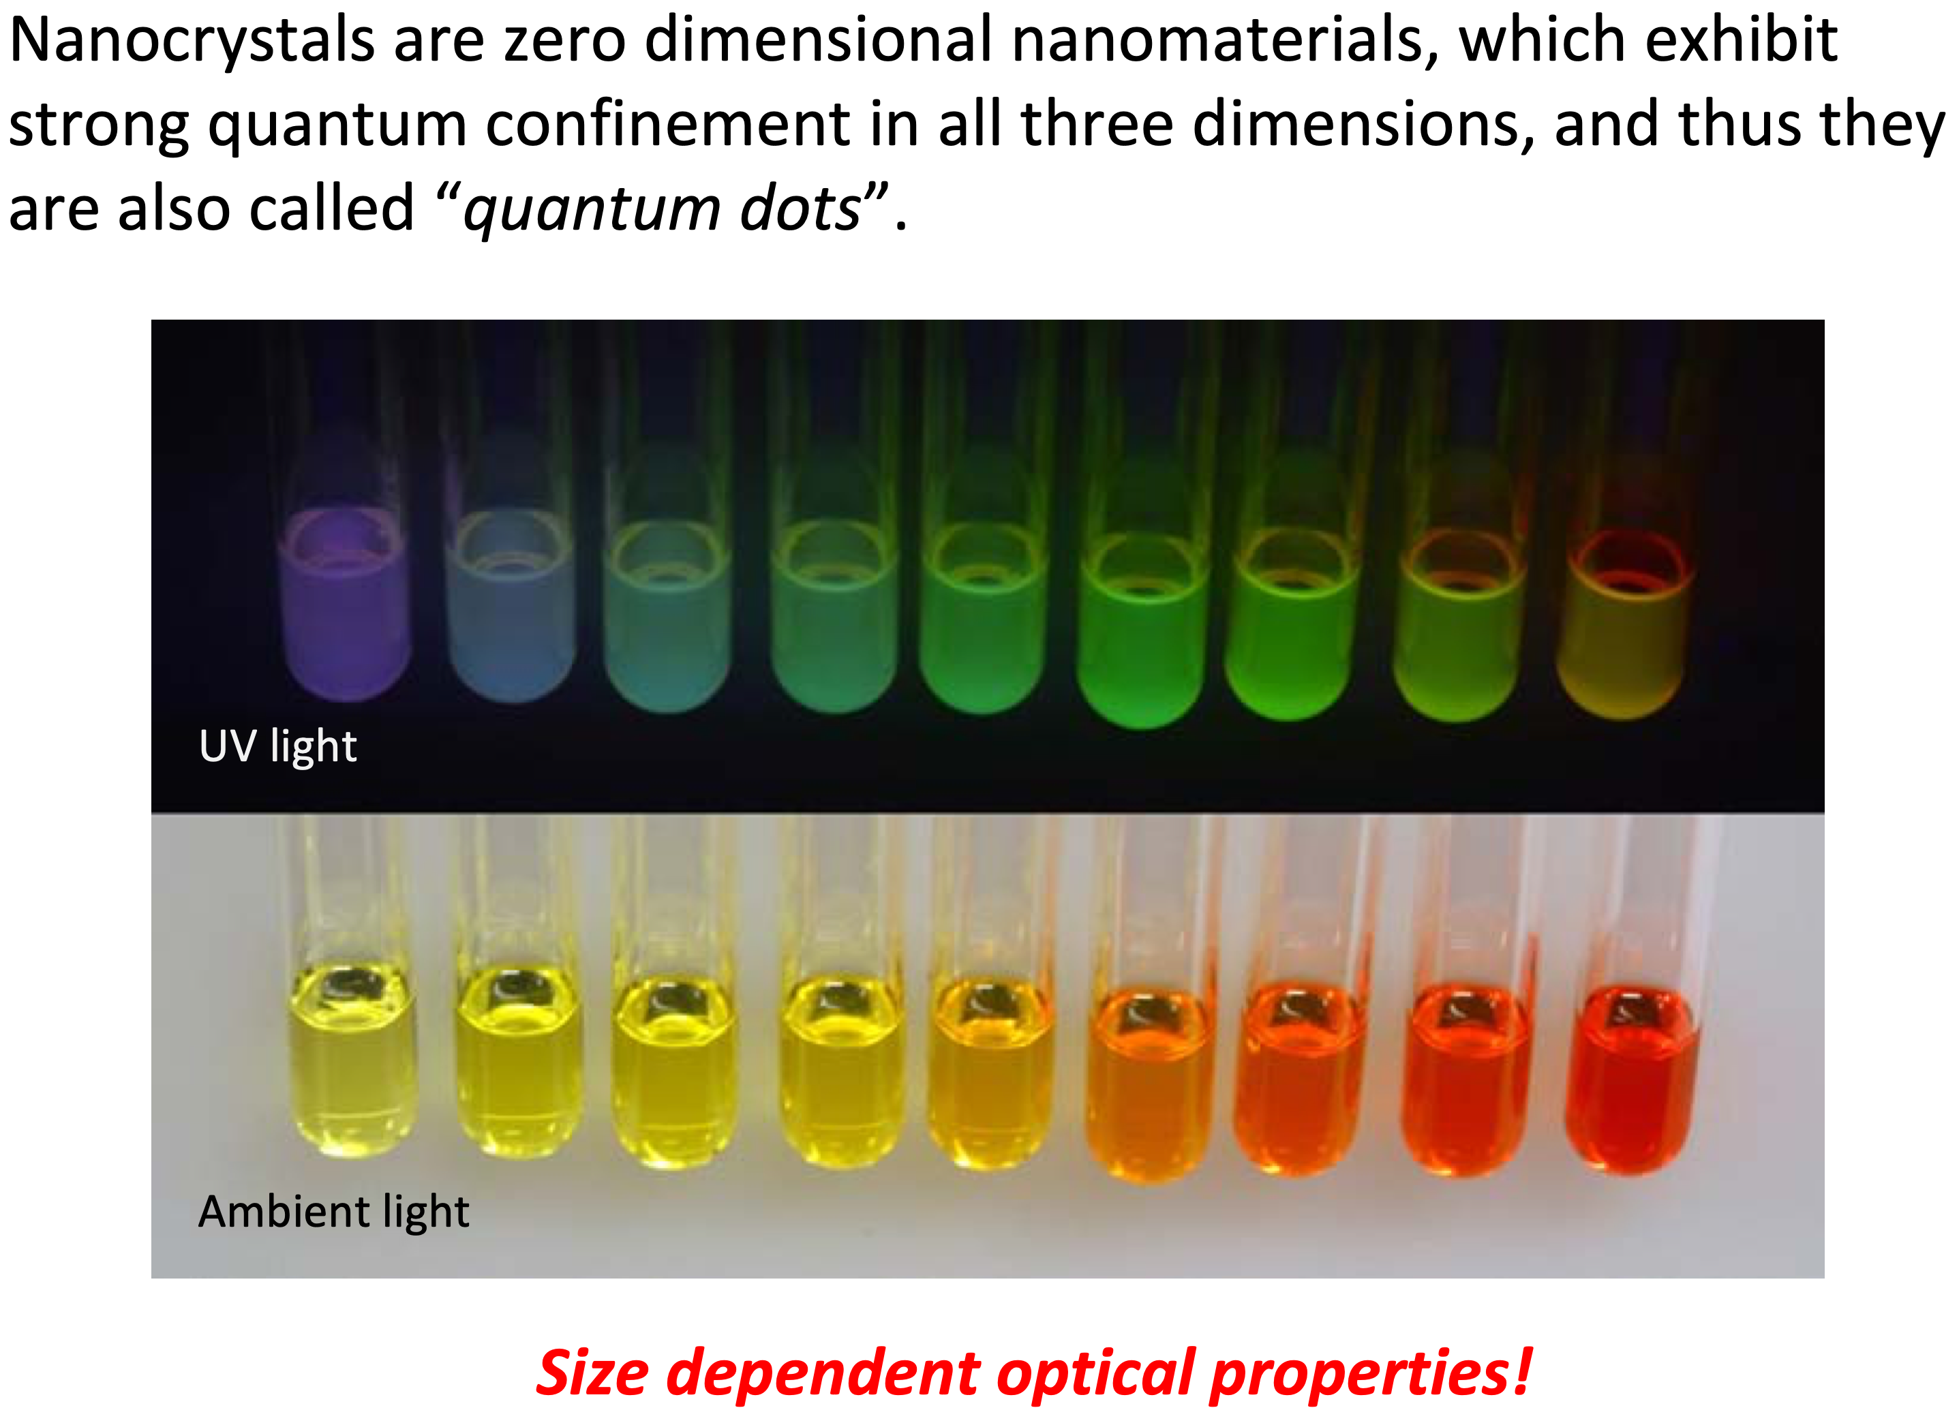

Slide 21
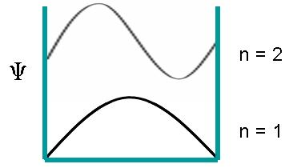
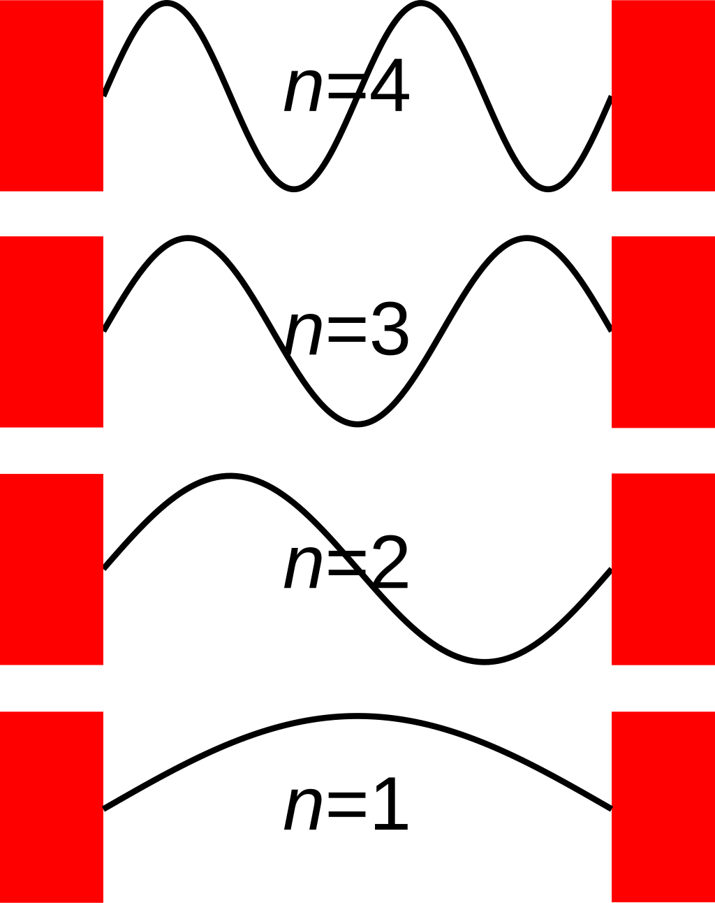
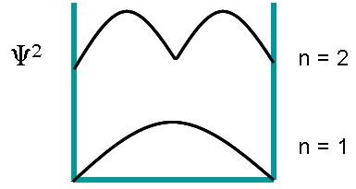
PIB wavefunctions
In classical physics, the probability of finding the particle is independent of the energy and the same at all points in the box
In QM, the square of the wavefunction is related to the probability of finding the particle in a specific position for a given energy level.
There are nodes where particles cannot be found!
At higher energy, the probability is more uniform
$$Ψ_{n}(x)=\sqrt{\frac{2}{L}}sin\left(\frac{nπx}{L}\right)$$
https://chem.libretexts.org/Bookshelves/Physical_and_Theoretical_Chemistry_Textbook_Maps/Supplemental_Modules_(Physical_and_Theoretical_Chemistry)/Quantum_Mechanics/05.5%3A_Particle_in_Boxes/Particle_in_a_1-Dimensional_box
By Papa November - Own work, CC BY-SA 3.0, https://commons.wikimedia.org/w/index.php?curid=8648347

Slide 22
2D PIB
Solution is based on separation of variables
$$Ψ_{n_{1},n_{2}}=\frac{2}{\sqrt{L_{1}L_{2}}}sin\left(\frac{n_{1}πx}{L_{1}}\right)sin\left(\frac{n_{2}πx}{L_{2}}\right)$$
$$E_{n_{1},n_{2}}=\frac{h^{2}}{8m}\left(\frac{n_{1}^{2}}{L_{1}^{2}}+\frac{n_{2}^{2}}{L_{2}^{2}}\right)$$
$$n_{1}=1,2,...;n_{2}=1,2,...$$
Note that
Like 1D, has a zero-point energy and is quantized
If $L_{1}=L_{2}$, then $E_{n_{1},n_{2}}=\frac{h}{8mL^{2}}\left(n_{1}^{2}+n_{2}^{2}\right)$ and there can be degeneracy, multiple states with the same energy

Slide 23
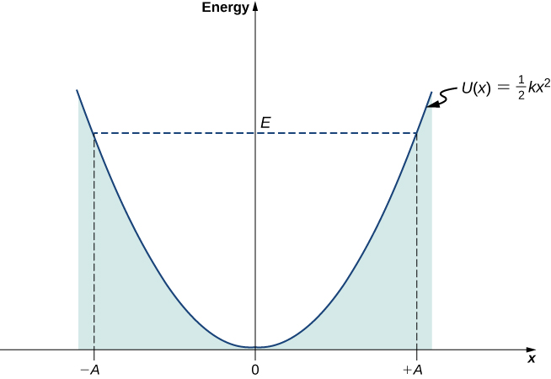
Harmonic Oscillator
$$V(x)=\frac{1}{2}kx^{2}$$
It is qualitatively similar to a particle in a box. Are energies continuous or quantized?
Quantized
https://phys.libretexts.org/Bookshelves/University_Physics/University_Physics_(OpenStax)/University_Physics_III_-_Optics_and_Modern_Physics_(OpenStax)/07%3A_Quantum_Mechanics/7.06%3A_The_Quantum_Harmonic_Oscillator

Slide 24
HO Solutions
The Hamiltonian is $\overset{̂}{H}=-\frac{ℏ^{2}}{2m}\frac{d^{2}}{dx^{2}}+\frac{1}{2}k_{f}x^{2}$
$Ψ_{ν}(x)=N_{ν}H_{ν}(αx)e^{-α^{2}x^{2}/2}$, where
$N_{ν}={\left(\frac{α}{2^{ν}ν!π^{1/2}}\right)}^{1/2}$ is for normalization
$$H_{ν}(y)=(-1)^{ν}e^{y^{2}}\frac{{\text{d}}^{ν}}{\text{d}y^{ν}}e^{-y^{2}}$$
$$α={\left(\frac{mk_{f}}{ℏ^{2}}\right)}^{1/4}$$
$H_{ν}$ are known as Hermite polynomials
For $ν=1$, the solution is Gaussian
The energies are $E_{ν}=\left(ν+\frac{1}{2}\right)ℏω$, where $ν=0,1,2,...$
$ν$ starts at 0, not 1
Spacings between energy levels are constant

Slide 25
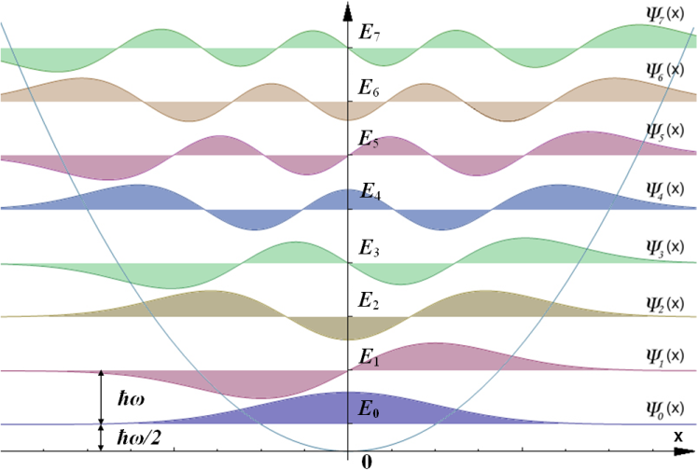
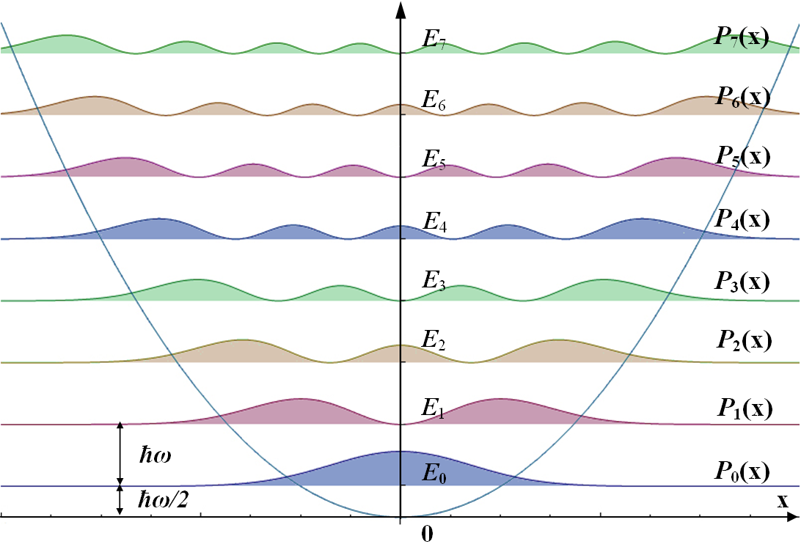
HO Wavefunctions and Probability Densities
By AllenMcC. - File:HarmOsziFunktionen.jpg, CC BY-SA 3.0, https://commons.wikimedia.org/w/index.php?curid=11623546
By Allen McC. at German Wikipedia - Eigene Darstellung, Public Domain, https://commons.wikimedia.org/w/index.php?curid=11542014

Slide 26
HO Applications
A good first-order model for any potential energy surface. There are anharmonicity corrections that are useful to better model potential energies.
IR spectrum of a diatomic molecule
Only transitions between adjacent energy levels where there is a change in dipole moment are allowed.
These all have the same energy, the fundamental vibrational frequency.
$ΔE=ℏν_{obs}$, where $ν_{obs}=\sqrt{\frac{k}{μ}}$ and $μ=\frac{m_{1}m_{2}}{m_{1}+m_{2}}$

Slide 27
Review
What is the relationship between uncertainty and the commutator?
When is energy quantized?
What is the general solution of the time-independent Schrodinger equation for a free particle?
What is quantum penetration and tunneling?
How do PIB wavefunctions and energies differ from classical expectations?
How do PIB and HO energy levels differ from each other?
Name systems that the PIB and HO are good models for.

